Slide 1
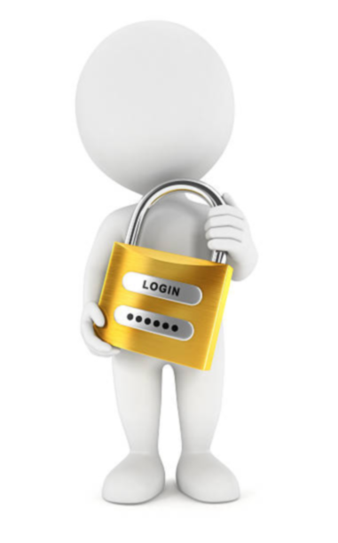
Password Manager
TEAM 1 C2
By:
Mahdi Bathallath – {2236809}
Taha Barzanji – {2135092}
Mohammed AlShehri – {2042124}

Slide 2
Process
Specifications
Design
Implementation
Testing

Slide 3

Specifications
GUI using PyQt5
Create and associate passwords
Master lists
Encryption
Accept Remote files
Local files

Slide 4
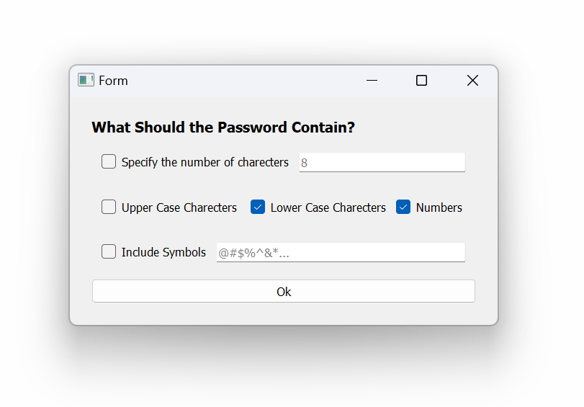
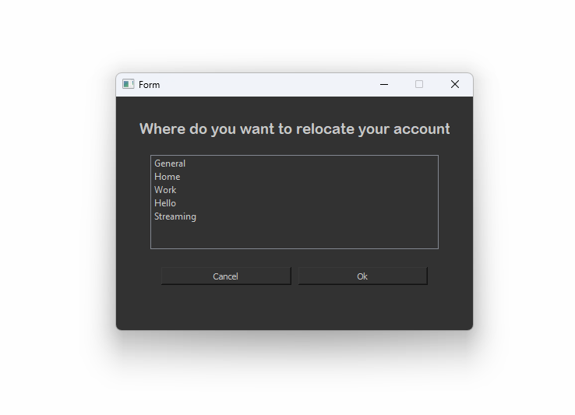
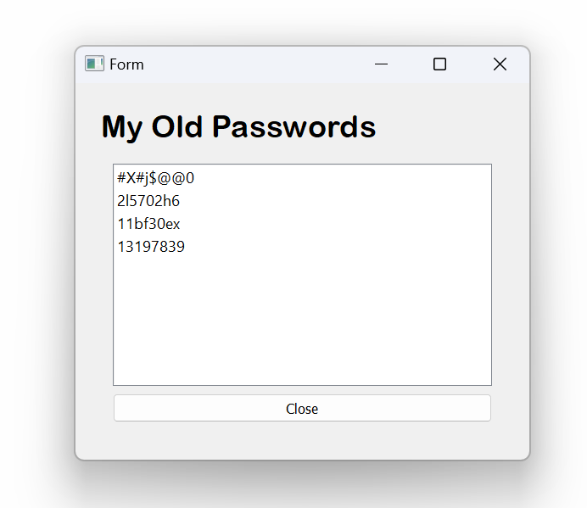
Extra Features
Password Generator with spec.
View Old Passwords
Recently Deleted
Restore Recently Deleted
Shortcuts

Slide 5

Design and Implementation

Slide 6
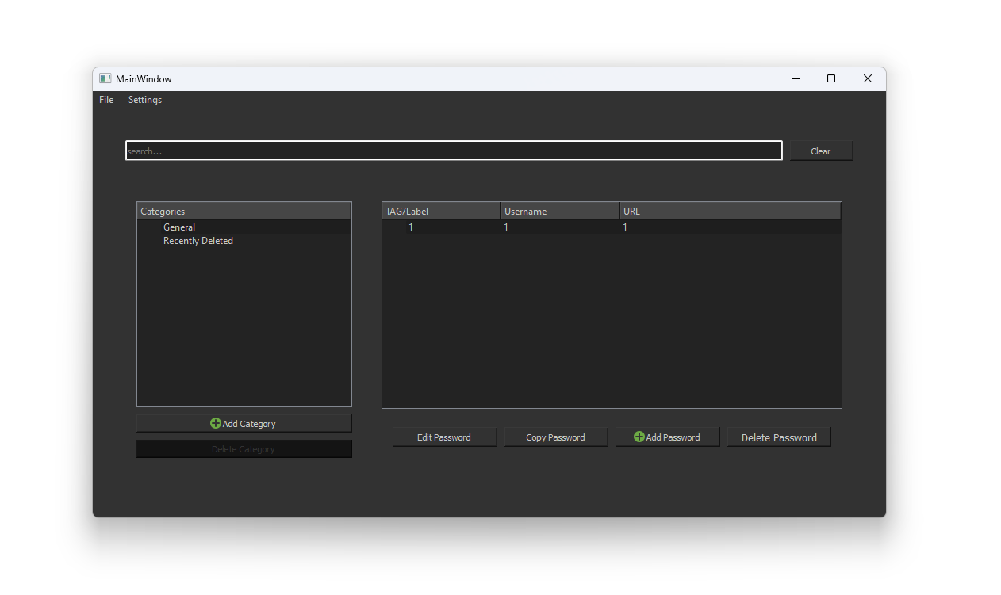

Slide 7
The Database
Passwords
Account
Category
Categories

Slide 8
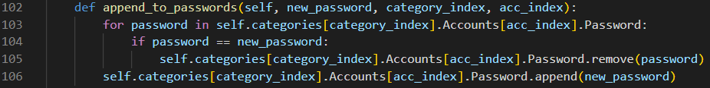
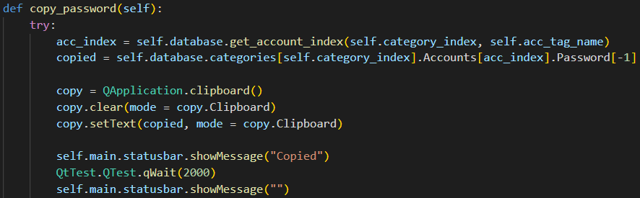
Accessing Old Passwords

Slide 9
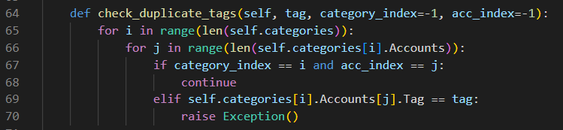
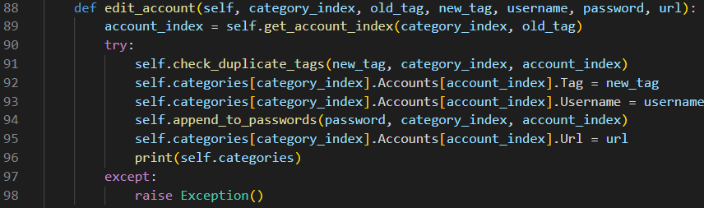
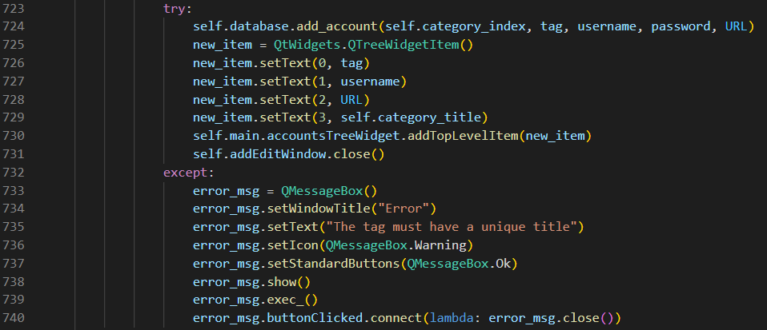
Tag Duplicates
First check
Then change

Slide 10
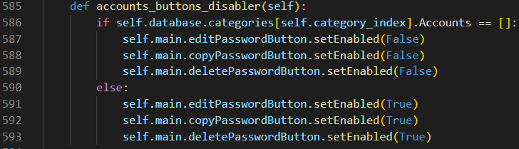
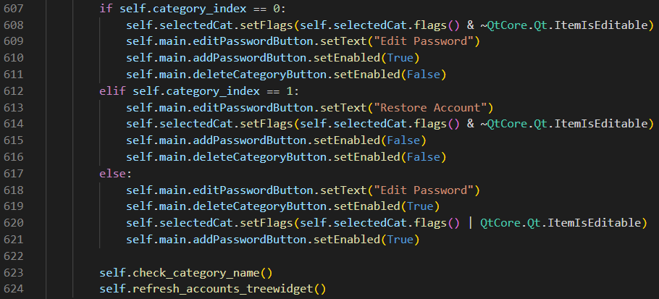
Account and Button accessibility

Slide 11

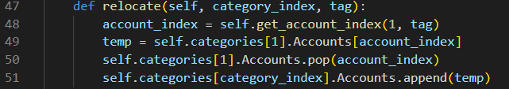
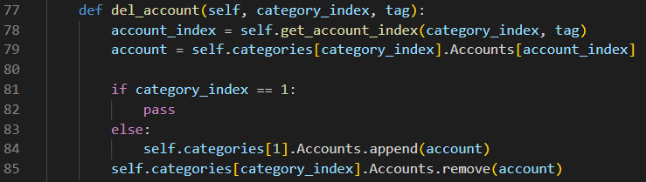
Accessing index of item in category
Edit Account
Del Account
Copy Account

Slide 12

Testing

Slide 13
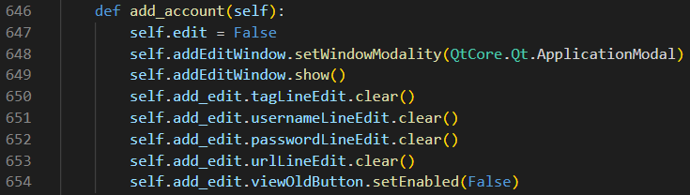
Set Window Modality
Change category index
Change account index
=> end up in unwanted place

Slide 14
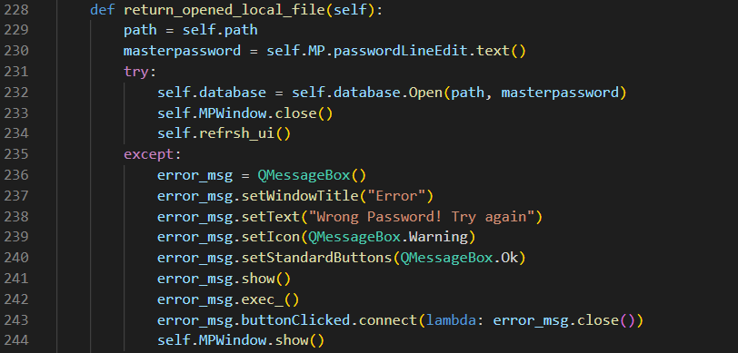
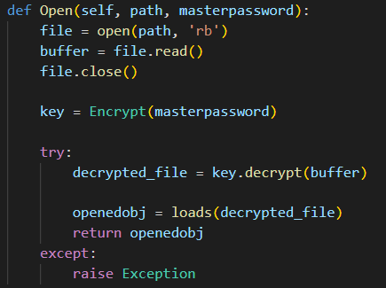
Expectation Handling

Slide 15
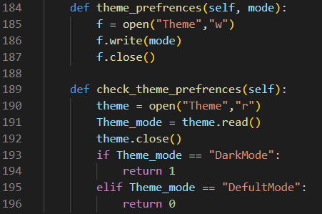

Theme Preferences
__INIT__

Slide 16
Conclusion
Learned
Used
Flaws
Next

Slide 17


Completed Work alone
Mahdi Bathallath | Taha Barzanji | Mohammed AlShehri

Slide 18
Task Weighting
TASKS | Mahdi Bathallath | Taha Barzanji | Mohammed AlShehri
UI Sketch {5%} | ✓ | ✓ | x
UI Creation {5%} | ✓ | ✓ | x
Data Structure {20%} | ✓ | ✓ | x
UI with triggers {10%} | ✓ | ✓ | x
Open/Save files {10%} | ✓ | ✓ | x
Open URL {5%} | ✓ | ✓ | x
Encryption {5%} | ✓ | ✓ | x
Packaging {20%} | ✓ | ✓ | x
Extra Features {20%} | ✓ | ✓ | x
TOTAL Contribution: | 51% | 49% | 0%

Slide 19

Any Questions

